Slide 2
Chapter 4, LO1, key terms 1
Describe the different ways medications can be ordered
Define the following terms:
stat
in medical facilities, a designation of urgency.

Slide 3
LO 1, content 1
Describe the different ways medications can be ordered
REMEMBER:
Prescriptions are usually given to patients in outpatient settings (e.g., a doctor’s office) and taken to a pharmacy to fill
Medication orders are used in long-term care and inpatient settings; they are made by a doctor or other qualified practitioner and the medications usually prepared, packaged, and delivered by a pharmacy

Slide 4
LO 1, content 2
Describe the different ways medications can be ordered
These practitioners are allowed to order medications in most states:
Physician (MD, DO)
Physician assistant (PA)
Clinical pharmacist
Advanced practice registered nurse (APRN)/nurse practitioner (NP)
Dentist
Optometrist

Slide 5
LO 1, content 3
Describe the different ways medications can be ordered
Not all healthcare workers are allowed to receive or transcribe (put into writing) medication orders. In most states, these are the team members who can receive medication orders:
Registered nurse (RN)
Licensed practical nurse (LPN)
Licensed vocational nurse (LVN)
Pharmacist

Slide 6
LO 1, content 4
Describe the different ways medications can be ordered
REMEMBER:
Medication aides should not receive stat medication orders or administer emergency medications

Slide 7
LO 1, content 5
Describe the different ways medications can be ordered
Critical Thinking: Demonstration and Discussion
Have you ever played “telephone”?
Play a round of telephone with the medication order whispered to the first student by the instructor.
Was the “order” correct when it got to the last person? What are some ways an order could be miscommunicated? What could this remind us about communicating about medications with other team members?

Slide 8
LO2, content 1
List the elements of a complete medication order
These are the elements of a complete medication order:
Identification of resident and prescriber
Drug name
Strength
Dosage form
Dose
Directions for use
Refills

Slide 9
LO2, content 2
List the elements of a complete medication order
Medication orders establish the “rights” of medication administration:
Right patient (resident)
Right drug
Right dose
Right route
Right time
Chapter 7 includes more information on these and other “rights”

Slide 10
LO3, key terms 1
Explain documentation of medication administration
Define the following terms:
medication administration record (MAR)
a permanent part of a resident’s medical record detailing all medications the resident receives.
eMAR
electronic version of a resident’s medication record.

Slide 11
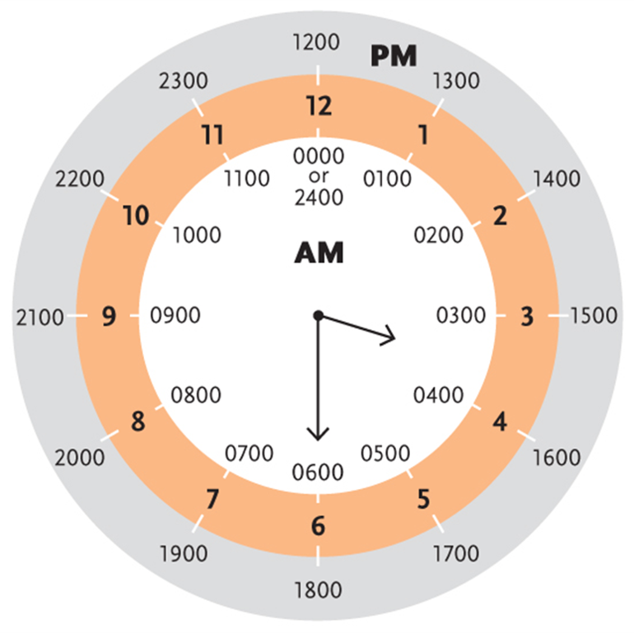
LO3, content 1
Key Material 4-1: 24-Hour Clock

Slide 12
LO3, content 2
Explain documentation of medication administration
Remember the following when documenting using the 24-hour clock (sometimes called military time):
To change the regular hours between 1:00 p.m. and 11:59 p.m. to military time, add 12 to the regular time
To change from military time to regular time, subtract 12
Minutes and seconds do not change
Midnight may be written as 0000 or 2400; follow facility policy

Slide 13
LO3, content 3
Explain documentation of medication administration
Key points about the MAR:
It is a legal record of the medications a resident receives
It provides information for decisions about a resident’s care
Careful documentation in the MAR ensures resident safety

Slide 14
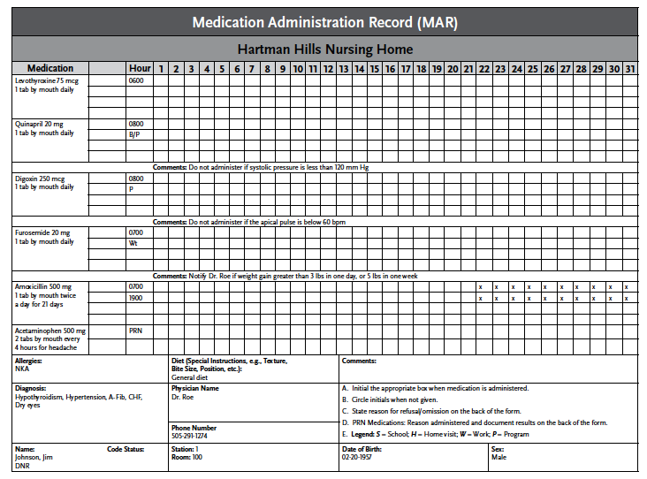
LO3, content 4
Key Material 4-2: Medication Administration Record (MAR)

Slide 15
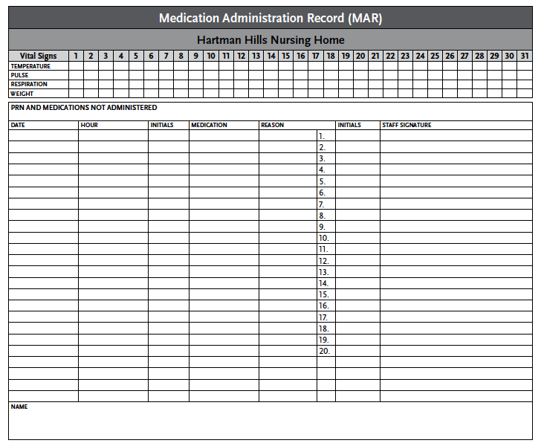
LO3, content 5
Key Material 4-2: Medication Administration Record (MAR) (cont’d)

Slide 16
LO3, content 6
Explain documentation of medication administration
All of this information is found on the MAR:
Drug name and dosage
How often the resident receives the medication
Route of administration and any special instructions for administration
Start date and time and stop date and time, as applicable
For PRN medications, indications for the medication (when it should be received/for what reasons)

Slide 17
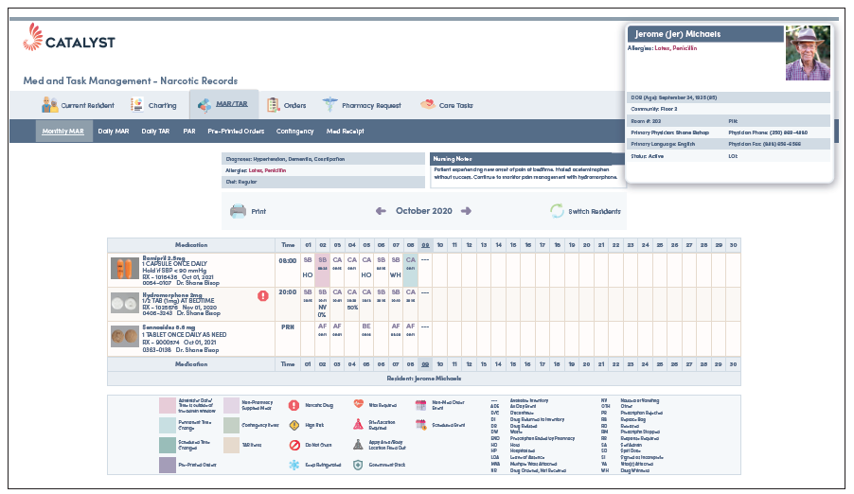
LO3, content 7
Key Material 4-3: eMAR (courtesy of Catalyst Healthcare)

Slide 18
LO3, content 8
Explain documentation of medication administration
Note the following features of eMAR systems:
May include a photo of the resident to aid identification
May include photos of the medication
May include information regarding side effects or other important points regarding ordered drugs
Some eMAR systems include links to detailed drug reference information

Slide 19
LO3, content 9
Explain documentation of medication administration
Remember these points about documenting on the MAR:
Every medication administered must be initialed by the MA (eMAR systems vary, but all will incorporate a method for confirming administration)
Some medications require that vital signs (e.g., blood pressure, pulse) be measured before administration; these measurements must also be documented
If a dose is refused or not given for any other reason, this must be documented and reported to the nurse
MAs should follow facility policy for documenting PRN medications; in most cases a follow-up entry about the effects of the medication is required
All documentation of resident care must be completed when care is provided
All documentation must be completed by the person who administered the medication

Slide 20
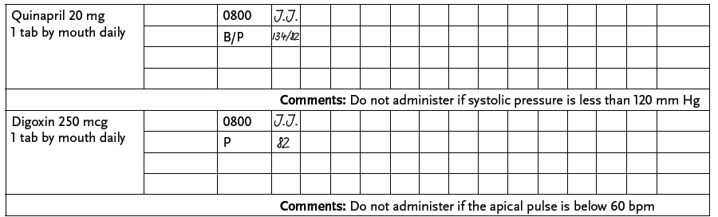
LO3, content 10
Key Material 4-4: Documenting on a Paper MAR

Slide 21
LO3, content 11
Explain documentation of medication administration
REMEMBER:
In addition to initialing to document administration, measurements for any required vital signs must be entered

Slide 22
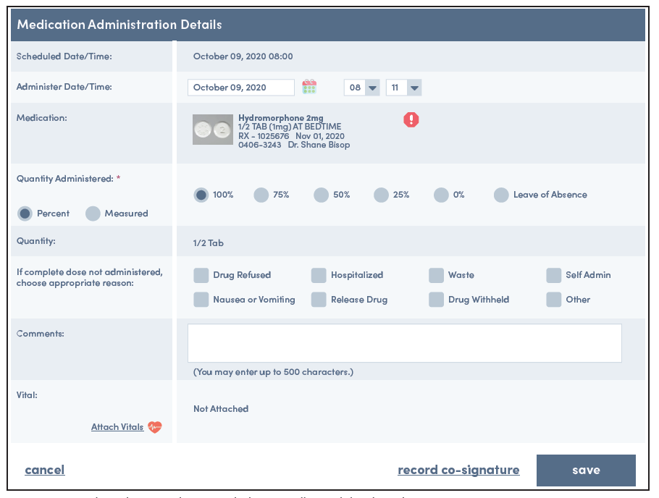
LO3, content 12
Key Material 4-5: Documenting in an eMAR System (courtesy of Catalyst Healthcare)

Slide 23
LO3, content 13
Explain documentation of medication administration
REMEMBER:
When documenting in an eMAR system there are usually prompts and menus to ensure no documentation is left out

Slide 24
LO3, content 14
Explain documentation of medication administration
Critical Thinking: Conversation Starter
Read the Safety First box on p. 30 of the textbook.
Can you think of any other ways that improper documentation could endanger a resident?
What might happen if an MA does not document that a resident refused a dose of medication?
What might happen if an MA forgets to check pulse or blood pressure but documents a normal reading?

Slide 25
LO4, key terms
Explain the controlled substances medication log
Define the following terms:
opioid
a type of controlled medication used to treat pain; used with care due to high risk of addiction and abuse; can also cause over-sedation in elderly people.
dispense
in healthcare, to provide a prescribed medication (e.g., from a pharmacy.)
countback balance
in a controlled substance count, the amount of a drug in storage before it is dispensed.
forward balance
in a controlled substance count, the amount of a drug remaining after it has been dispensed.

Slide 26
LO4, content 1
Explain the controlled substances medication log
These measures may be used to prevent intentional or accidental misuse of controlled medications:
Some facilities (especially hospitals) may have automated dispensing cabinets that store and dispense drugs and automatically track amounts used
All controlled substances are kept in double-locked storage areas
A controlled substance log is maintained and updated at each shift change
Two people must be present every time a count takes place
A controlled substance log includes
Drug name, strength, and dosage form
Name of person who dispenses the drug, with the date and time
Amount of drug dispensed
Countback balance and forward balance

Slide 27
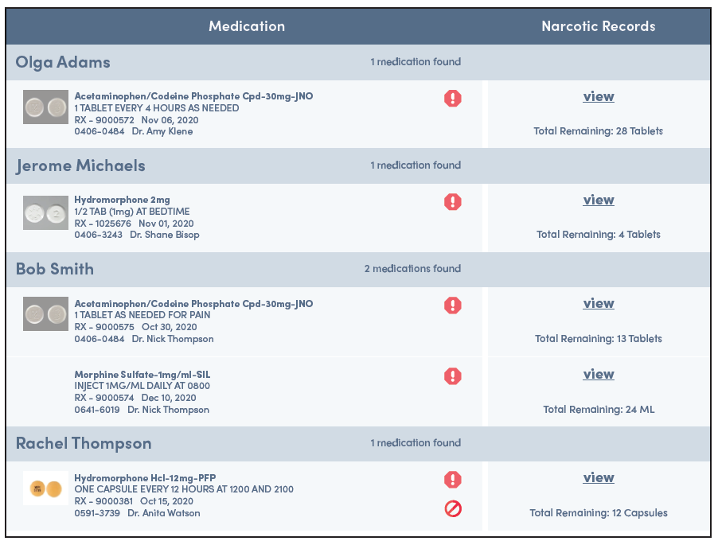
LO4, content 2
Key Material 4-6: eMAR Controlled Substance Count (courtesy of Catalyst Healthcare)

Slide 28
LO5, key terms
Describe how to observe and report accurately
Define the following terms:
objective information
information based on what a person sees, hears, touches, or smells; also called signs.
subjective information
information that a person cannot or did not observe, but is based on something reported to the person that may or may not be true; also called symptoms.
anaphylactic reaction
a dangerous allergic reaction to a medication or other substance; may cause swelling of the lips, tongue, and throat that can obstruct the airway; also called anaphylaxis.
hypertensive emergency
systolic blood pressure greater than 180 mm Hg or diastolic blood pressure greater than 120 mm Hg.

Slide 29
LO5, content 1
Describe how to observe and report accurately
Remember these basic points about accurate observing and reporting:
Facts, not opinions, are most useful to the nurse and care team
Objective information is collected using the senses; it can be experienced the same way by different people and is also called signs
Subjective information is based on something reported and it may or may not be true; also called symptoms

Slide 30
LO5, content 2
Describe how to observe and report accurately
REMEMBER:
Vital signs are a type of objective information. They may need to be measured and recorded before administering some medications.

Slide 31
LO5, content 3
Describe how to observe and report accurately
The following signs and symptoms should be reported immediately:
Chest pain
Severe headache
Difficulty breathing
Abnormal pulse, respiration, or blood pressure
Change in mental status
Sudden weakness or loss of mobility
High fever
Loss of consciousness

Slide 32
LO5, content 4
Describe how to observe and report accurately
Signs and symptoms to report immediately:
Change in level of consciousness
Bleeding
Swelling
Change in resident’s condition
Events (such as falls) that could be health-threatening
Resident reports that medications produce no results or undesirable effects
Resident refuses a medication

Slide 33
LO5, content 5
Describe how to observe and report accurately
REMEMBER:
Medication aides do not assess a resident’s need for a medication or reaction to medications, but their observations and reports are very important to resident health

Slide 34
LO5, content 6
Describe how to observe and report accurately
MAs should know the signs/symptoms of these conditions, which may be life-threatening and must be reported immediately:
Anaphylactic reaction (marked by swelling of the lips, tongue, throat)
Hypertensive emergency (blood pressure greater than 180 mm Hg systolic or 120 mm Hg diastolic)

Slide 35
LO5, content 7
Describe how to observe and report accurately
Critical Thinking: Case Studies
What objective and subjective information might an MA observe and report for each of these cases?
Case Study #1
Mrs. Surch has been taking a new medication for several days. Just as the MA arrives, Mrs. Surch is in the bathroom vomiting. She says she has felt sick to her stomach since she started taking the medication. Mrs. Surch is squinting her eyes and holding her head as she returns to bed. She does not have a fever.

Slide 36
LO5, content 8
Describe how to observe and report accurately
Critical Thinking: Case Studies (cont’d)
Case Study #2
Mr. Rivers has been taking the same blood pressure medication for more than a year, but his dose was recently increased. The MA notices that he has stopped participating in exercise classes. He reports feeling dizzy. When he gets out of bed he appears unsteady.

Slide 37
LO 6, content 1
Discuss how to resolve questions about medication orders
Never administer a medication if information about the medication is not complete. Remember these points:
If the MAR is missing any information, contact the nurse
Do not administer a medication until the information on the MAR is complete.
Understand the purpose of the medications you administer. If you are administering a medication for the first time and do not know what it is for, use a drug reference book or website to learn about the medication
Remember that MAs never make decisions about how or whether a resident receives a medication. Any questions must be directed to a nurse or doctor

Slide 38
LO 6, content 2
Discuss how to resolve questions about medication orders
Critical Thinking: Conversation Starter
What if . . . ? Consider each of these situations. What would you do?
Medication dosage is not listed on a resident’s MAR, though the medication comes packaged in 20 mg doses
A resident’s MAR indicates that she is to stop taking an antibiotic after three days. Her medication drawer contains a seven-day supply of the drug and signs and symptoms suggest she is still not over the illness on the third day
A resident whose MAR indicates a penicillin allergy has an order for penicillin
A resident who has always had high blood pressure has a new order for a PRN decongestant with a warning that it is not suitable for people with high blood pressure

